Slide 1


DSRI Community Event
2nd December 2020

Slide 2
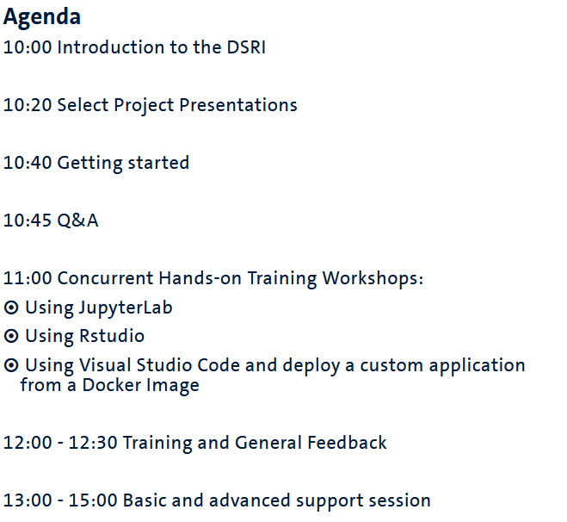
DSRI Community Event
(Zoom break out rooms)

Slide 3

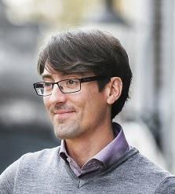





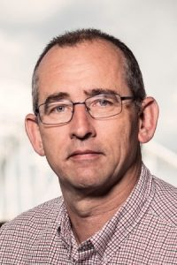

DSRI Team
Chris Kuipers
ICTS
Linux System Engineer
Michel Dumontier
Institute of Data Science
Project Lead
Marcel Brouwers
ICTS
Linux System Engineer
Vincent Emonet
Institute of Data Science
Support
Jordy Frijns
ICTS
Linux System Engineer
Binosha Weerarathna
Institute of Data Science
User outreach and training
Armand Habets
ICTS
Product Manager
Arjen van Wijngaarden
Fourco
Consultant
Emiel Kremers
Fourco
Consultant

Slide 4
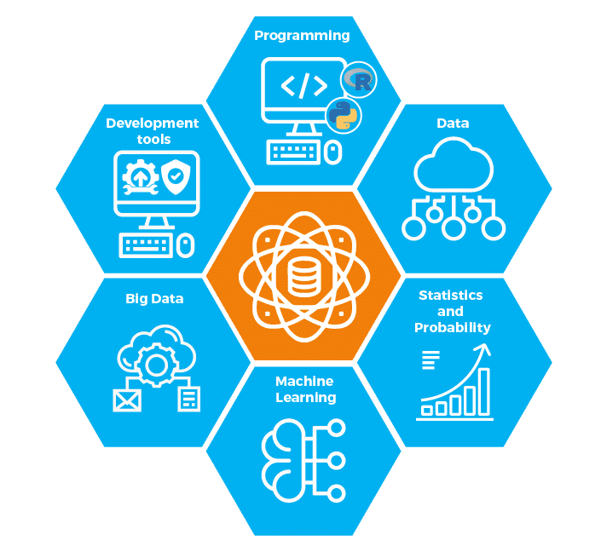
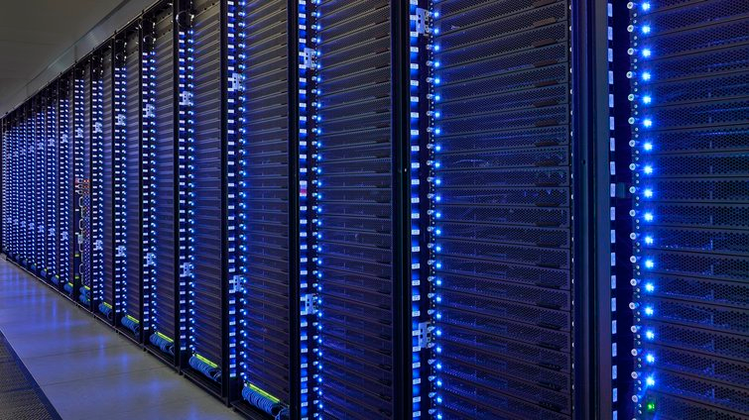
Vision
An effective, scalable, and sustainable data science computing infrastructure at Maastricht University
initiated in 2018 as a collaboration between the Institute of Data Science and ICTS

Slide 5
Vision
An effective, scalable, and sustainable data science computing infrastructure at Maastricht University
Effective in that DSRI helps you get data science work done with much less administration
Scalable in both that you can use more resources for your problem, and that we can grow the cluster when needed
Sustainable in that it is an infrastructure that is maintained by its community of users along with the UM

Slide 6
Why is DSRI needed?
Lack of a shared research computing infrastructure has resulted in multiple isolated, incompatible, and independently managed infrastructures that have differing policies and patchy compliance to organizational, national and international regulations, that cannot be combined.
Researchers should focus on their research, instead of being burdened with administrating computational infrastructure
UM wants to make research results FAIR - Findable, Accessible, Interoperable, Reusable - a shared infrastructure would foster best practices to help researchers achieve FAIR and reproducible research and workflows.
A shared infrastructure will enhance the position of the UM and help attract and retain data science talent

Slide 7
Design Objectives
An infrastructure that
Facilitates large scale data analysis using big data technologies using both CPU + GPU computing
Reduces administrative overhead with self-administrative user interfaces
Enables component deployment via containers (Docker)
Enables data sharing via a flexible and shared storage solution
Is scalable and fault-tolerant by combining global monitoring with auto-migration

Slide 8
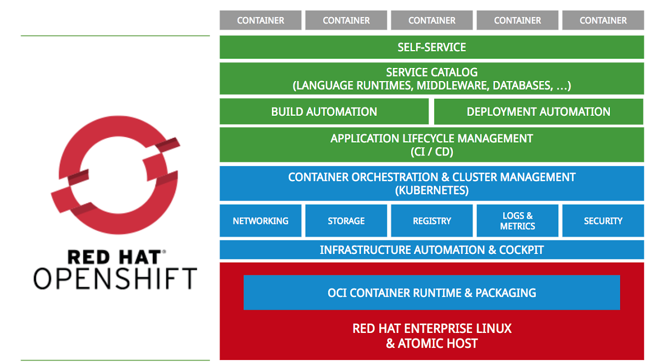
An Orchestrated Solution
Automated configuration, coordination, and management of DSRI
Orchestration using OpenShift and Kubernetes
MAPR platform is used as Hadoop compatible storage
Runs Docker-based containers

Slide 9
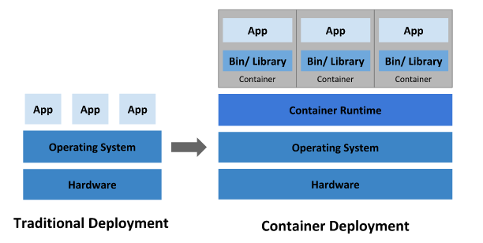
Containers have exactly what is needed to deploy an application
Applications are prepared with everything that is required to successfully deploy them elsewhere
Cloud and OS portability: runs on Ubuntu, RHEL, on-premises, and in major public clouds
Higher efficiency in using underlying compute resources through load balancing and scaleout
Protect underlying systems from application specific exploits
Easy for users to find and redeploy specific apps for their own use
Notes:
This diagram makes traditional deployment looks like simpler and more efficient

Slide 10
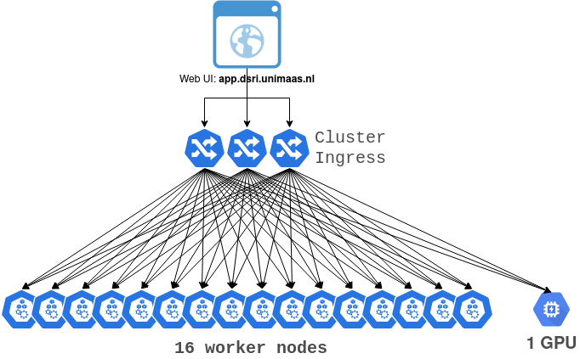
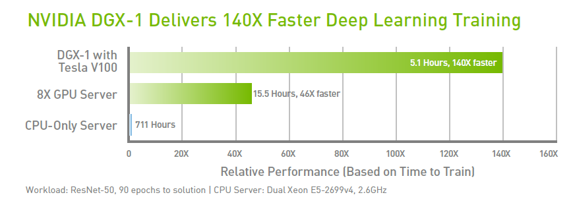
DSRI configuration
Cluster as of November, 2020 16x CPU nodes 2x AMD EPYC 7551 512 GB Memory
120TB (1920TB total) 1x GPU node (Nvidia DGX-1)
8x NVIDIA Tesla V100 32 GB/GPU
40,960 Nvidia CUDA cores
5,120 Tensor Cores 40 Gb/s interconnects

Slide 11

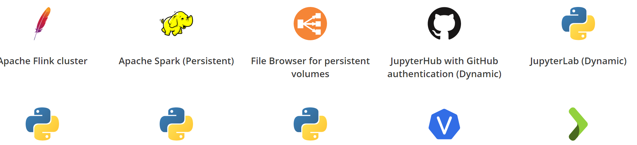





What can be done on the DSRI
Run Data Science applications in Docker container 🐳 on the UM network
JupyterLab (scipy, tensorflow, all-spark, and more)
JupyterHub with GitHub authentication
RStudio, with a complementary Shiny server
VisualStudio Code server
Tensorflow or PyTorch on Nvidia GPU
SQL, NoSQL and Graph databases (PostgreSQL, MongoDB, Blazegraph...)
Apache Flink cluster for Streaming applications
You can also deploy any customized container image (Docker)

Slide 12
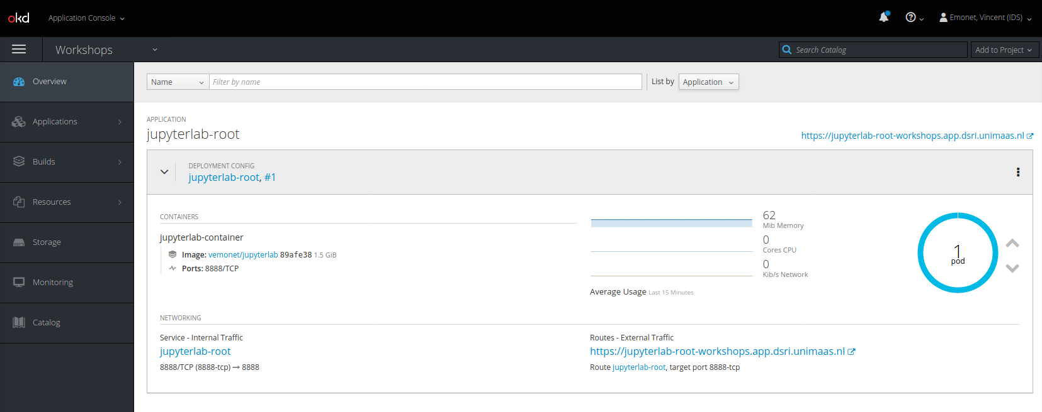
Manage your applications
Through the OpenShift Web UI (behind the VPN)
Or through the terminal using the oc command line interface
Which is better for some operations, such as loading large datasets

Slide 13
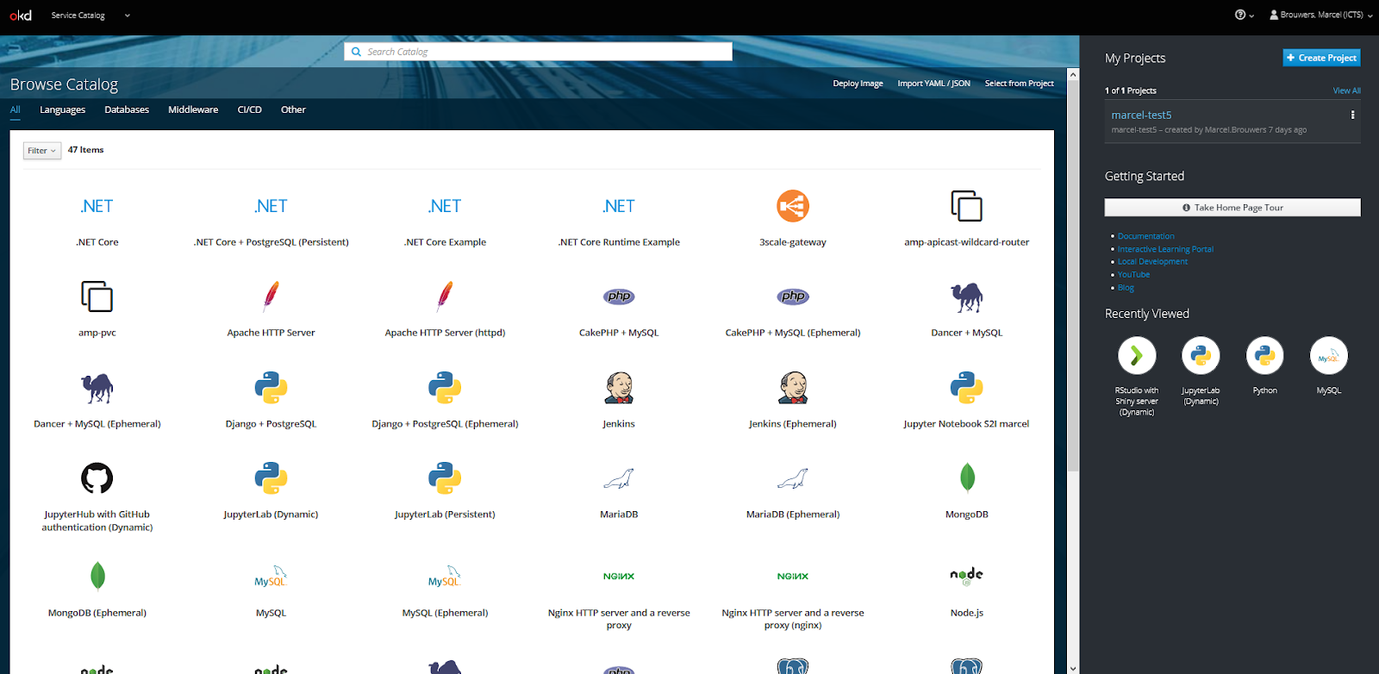
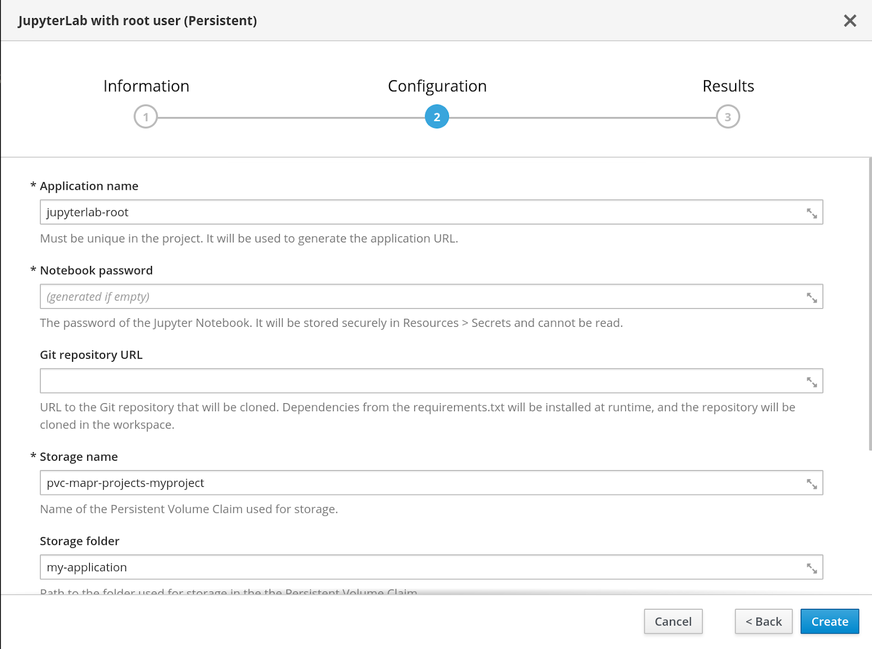
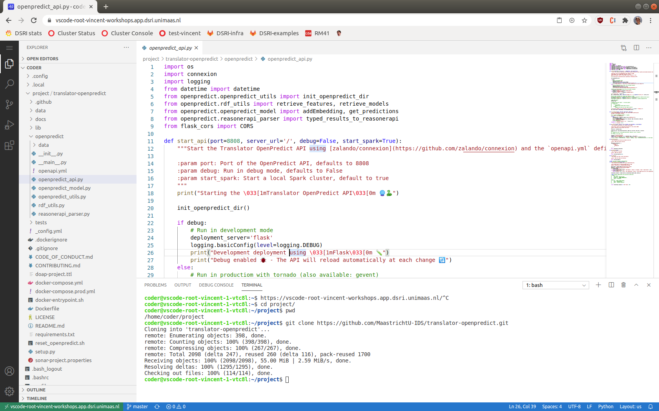
Deploy applications easily using templates
Find a template to deploy your data science application
Provide a few parameters to start the application
Access your application through its web UI
Ask for new templates if needed!
Such as name, password, storage location
Using a URL created by the DSRI
Or connect via the terminal

Slide 14
Or define your application deployment!
Any Docker image can be deployed on the DSRI with a “bit” of configuration
In short, you will need to write some YAML files to define the different how to deploy your app (port, storage, resources limitations, etc)
The DSRI supports Helm, the package manager for Kubernetes
To deploy existing deployments
Or create new deployments with multiple services easily
Notes:
Best practices: As example we noticed that it pushed some researchers without good knowledge of software development (such as SBE PhDs) to adopt some good practices that will make it easier for collaborators and supervisors to reuse those project and pieces of softwares
Instead of having some local code that only runs on their local machine, the use of the DSRI pushed the researchers to host their code in git repositories and properly provide all required dependencies to be installed in the container

Slide 15

DSRI Storage Solutions
Data will not be lost when pod get restarted
Ephemeral Storage
Dynamic storage
Persistent storage
Storage is bound to the pod
Data will be lost when the pod is deleted
We do not propose this solution anymore, feel free to ask us if you need it
Automatically create when starting an application
Can also be created in the OpenShift web UI
Does not work with container using the root user
Can be created by the DSRI team
Data will not be lost when pod get restarted.
Notes:
Ephemeral Storage: but this deployment does not require to request the creation of a persistent storage, and is faster to test code. When creating a pod, OpenShift will by default use ephemeral storage. It creates a volumes bind to the pod. So the volume will be deleted.
Dynamic storage is not working with container running as root, use Jupyter S2I deployments with this storage
We are recommending to use dynamic provisioning for a more sustainable storage solution. But ephemeral storage can be sufficient for testing.

Slide 16
Reasons to use the DSRI
Run your work on a remote server at UM through popular web UI (Jupyter notebooks, RStudio, VisualStudio Code) instead of your computer
Get faster results with 120 cores to parallelize tasks, or the 500GB memory to run large workloads
Make use of best practices (using git to version and share code) and provide shared environments (containers) to improve project FAIRness
Develop and share these results with your (UM) collaborators
Notes:
Best practices: As example we noticed that it pushed some researchers without good knowledge of software development (such as SBE PhDs) to adopt some good practices that will make it easier for collaborators and supervisors to reuse those project and pieces of softwares
Instead of having some local code that only runs on their local machine, the use of the DSRI pushed the researchers to host their code in git repositories and properly provide all required dependencies to be installed in the container

Slide 17
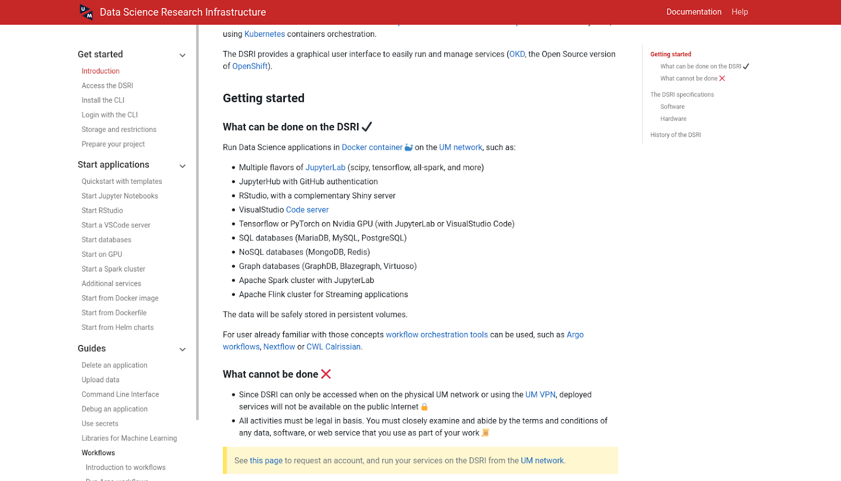
Collaborative documentation website
https://maastrichtu-ids.github.io/dsri-documentation

Slide 18
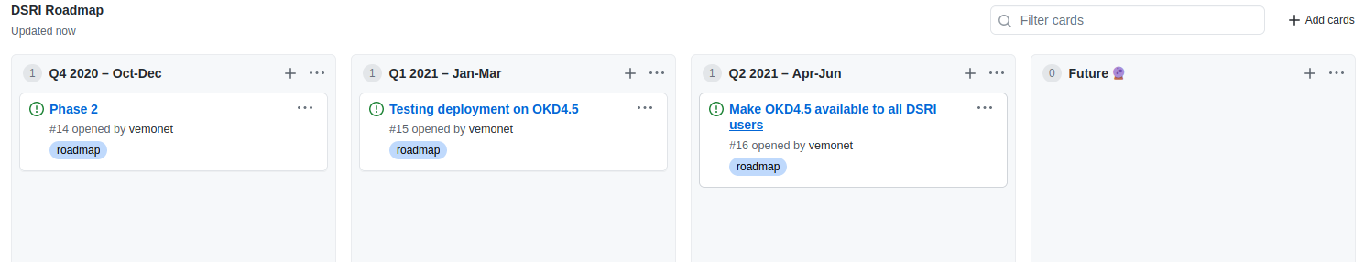
User Community
We use slack as instant messaging platform for DSRI communications
Get the invitation to Slack after registering to the DSRI
#helpdesk channel
Issues tracker on GitHub
https://github.com/MaastrichtU-IDS/dsri-documentation/issues
A public roadmap for the DSRI
https://github.com/MaastrichtU-IDS/dsri-documentation/projects/1
Notes:
Roadmap started on GitHub: https://github.com/MaastrichtU-IDS/dsri-documentation/projects/1
A repository for DSRI applications: https://github.com/MaastrichtU-IDS/dsri-openshift-applications/

Slide 19
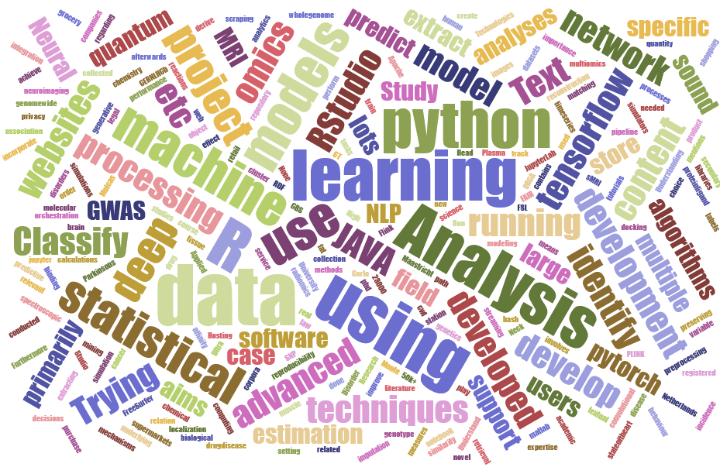
67 registered users and 50 documented projects
bigcat | Department of Bioinformatics | FHML
fhml | Faculty of Health, Medicine and Life Sciences | FHML
hsr | Department of Health Services Research | FHML
maastro | Maastro Clinic | FHML
NUTRIM | School of Nutrition and Translational Research in Metabolism | FHML
phartox | Department of Pharmacology & Toxicology | FHML
pn | Department of Psychiatry and Neuropsychology | FHML
tgx | Department of Toxicogenomics | FHML
Tech Lab | Law and Tech Lab | FL
dke | Department of Data Science and Knowledge Engineering | FSE
fse | Faculty of Science and Engineering | FSE
gwfp | Gravitational Waves and Fundamental Physics | FSE
ids | Institute of Data Science | FSE
lofse | LO-FSE | FSE
macsbio | MACSBIO System Biology | FSE
msp | Maastricht Science Program | FSE
MSCM |  | SBE
sbe | School of Business and Economics | SBE
icts | ICT services | UM
um | Maastricht University | UM
Wordcloud from project descriptions

Slide 20
Project presentation
CBCT to CT translation for Adaptive Radiotherapy
Notes:
TODO

Slide 21
What are our future plans?
A vibrant community-supported infrastructure
Weekly technical meetings and monthly planning meetings
Advice and feedback from new advisory board
Regular (2-3x annual) community meetings and training workshops
Improved user experience and multi-media documentation
Mon-Fri user support
Infrastructure improvements
testing OKD 4.5 on a subset of the cluster + CEPH storage (ongoing)
resource scheduling and quota management (GPU, CPU)
security, data protection, and disaster recovery policies
Deploy new Data Science and Machine Learning platforms
Apache Spark, OpenDataHub, KubeFlow, FAIRscape
Public-facing applications by the UM research community
Develop community-based governance and policies; invite new investors, secure long term financing, and grain external funding.

Slide 22
Workshop: Start an Application
Go to your breakout room
And follow the workshop instructions at
https://maastrichtu-ids.github.io/dsri-workshop-start-app

Slide 23
DSRI Community Event
(Zoom break out rooms)

Slide 24
Feedback
Share your thoughts on your first experience with the DSRI
What did you think about DSRI getting started and setup procedure?
What other applications would you like to see on the DSRI?
What would take it to get you starting to use DSRI (more?)
Notes:
https://forms.gle/QVqqdupgGat5FbNA6

Slide 25
Questions?

